Slide 1
Power BI - Basic
December 2024

Slide 2
Preparation
Have drinks and snacks at your fingertips
Make sure you’re in a quit place
The training is more comfortable with 2 screens
Download Files
Simplyflow.be – tab training documents
Open power BI
Open power BI . Com

Slide 3
Agenda
Introduction
Filtering, slicers
Publishing reports
Bookmarks
Power BI pro
Data Gateways (Concept)
Q & A time

Slide 4
introduction

Slide 5
Introduction
Power BI examples
Quick overview
Moving and resizing visuals
Interaction with pages
Creating, modifying, and formatting reports
Adding text boxes for annotations
Exporting data from visualizations
Hierarchies

Slide 6
Quick report example

Slide 7
Intro – quick overview
Power BI ribbon | The benefits of the ribbon are intended to make the experience across Power BI Desktop, as well as other Microsoft products, easy and familiar. It contains the principal options that are available to you when developing
View Type | You can switch between Report, Data, and Model views by selecting the icons in the left-hand navigation pane
Dashboard Canvas | You can add all sorts of visualizations to a page, but it's important not to overdo it. Too many visualizations on a page make it look busy and difficult to find the right information.
Filter Pane | You can apply filters in the Filters pane. The Filters pane shows the fields in individual visuals, and any other filters the report designer adds.
Visualization Properties | This area is specific to each type of visualization and lets you set the specific attributes of each element on a dashboard
Fields List | The field lists are being unified across Model view, Data view and Report view in Power BI Desktop. Unifying these views will create consistency for functionality and the user interface (UI) across views and addresses customer feedback.
Page selector | Allow you to switch from page to page, hide pages, delete pages in reports

Slide 8
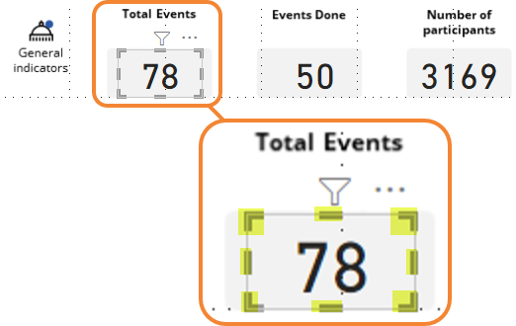
Intro – visuals
Visualizations/visuals | Data visualization helps you turn granular data into easily understood, visually compelling – and useful – business information.
Dashboard | A Power BI desktop dashboard can be seen as a page in Excel. It can contain a collection of visuals.
Report | Collection of Dashboards in a single file
Moving a visualization
Select the visual you want to move. For example, the Total Events. A frame around your visual will appear.
Select any place of the frame and drag it elsewhere on the dashboard canvas
Resizing a visualization
Select the visual you want to resize. For example, the Total Events. A frame around your visual will appear. Corners and side handles will appear (here in yellow).
Click on any corner or side handle. A double-headed arrow ( ) will appear allowing you to increase or decrease the current size of your visual.

Slide 9
Intro – Pages
Let’s interact with pages:
Adding pages
Renaming pages
Deleting pages
Moving pages
Duplicating pages
Scrolling through pages

Slide 10
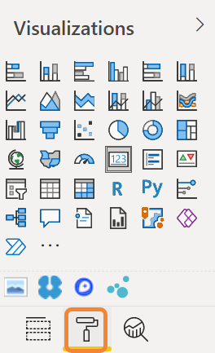
Intro - reports
Format pane
click on any visual
Click the “paint roller” in the visualization properties
This will display the Format Pane.
Tip
You can format multiple visuals if they are of the same type

Slide 11
Intro - reports
In Power BI, you can create reports with multiple visuals
All visuals can be formatted similarly. We will see how to format:
Borders
Background colors
Titles
Table gridlines
Data colors

Slide 12
Intro – Adding smart narrative visuals
You can add text boxes, shapes, and smart narrative visuals to reports in Power BI Desktop or the Microsoft Power BI service.
Note you must have editing permissions
Let’s add some static shapes, images and boxes

Slide 13
Intro – Exporting data
Your turn:
Export data
Bear in mind that the export is done with the existing filters.

Slide 14
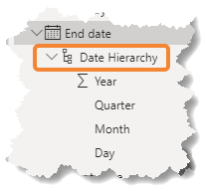
Intro - hierarchies
A hierarchy is a set of fields categorized in a hierarchical
way that one level is the parent of another level.
Example calendar data
Year – Quarter – Month – Week – Day
2021 – Q4 – October – week 43 - Thursday 28
Example product data
Category – subcategory –product
Clothing – men – white t-shirt

Slide 15
Intro - hierarchies
Let’s create a new hierarchy
Note: This can only be done in Power Bi desktop
Exercice: in a new power BI desktop file we will import
ProductHierarchy.xlsx

Slide 16
Filters and slicers

Slide 17
Filters
Levels
Data types
Adding, applying, clearing
Select all
Filter types
Multiple, page-level, report-level, removing

Slide 18
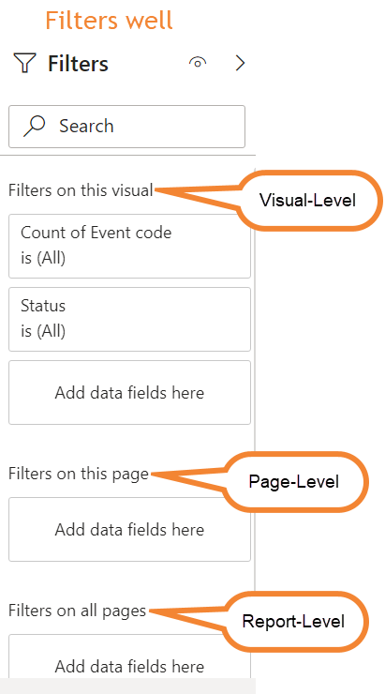
Filters – intro
Filterable data types
Text
Numeric values
Dates
Logical values
Type | Description
Visual-level | Filters only the selected visual
Page-level | Filters all visuals in the current page
Report-level | Filters all the visuals in the current file

Slide 19
Filters – Add, apply, clear
Your turn:
Add
Apply
Clear
Select all
Blank: no filters are selected
Checked: all filters are selected
Dotted: some filters are selected

Slide 20
Filter types (non exhaustive list)
Basic
allows to manually select items
Advanced
allows to select ranges
selection based on words, letters
Top N
allows to return data according to a specified number or date
Relative
allows you to find data in specified period

Slide 21
Filter different types of data
Numeric filter options
Filter option | Description
Is Less Than | The selected field is less than the number you are searching for
Is Less Than Or Equal To | The selected field is less than or equal to the number you are searching for
Is Greater than | The selected field is greater than the number you are searching for
Is Greater Than Or Equal To | The selected field is greater than or equal to the number you are searching for
Is | The selected field matches exactly the number you are searching for
Is Not | The selected field does not exactly match the number you are searching for
Is Blank | The selected field is blank
Is Not Blank | The selected field is not blank

Slide 22
Filter different types of data
Date and Time filter options
Filter option | Description
Is | The selected field contains the date you are searching for
Is Not | The selected field does not contain the date you are searching for
Is After | The selected field contains dates after the date you are searching for
Is On Or After | The selected field contains dates beginning with the date you are searching for or later
Is Before | The selected fields contains dates before the date you are searching for
Is On Or Before | The selected fields contains dates on or before the date you are searching for
Is Blank | The selected field is blank
Is Not Blank | The selected field is not blank

Slide 23
Filter different types of data
Text filter options
Filter option | Description
Contains | The selected field contains the search text anywhere in the field data
Does Not Contain | The selected field does not contain the search text anywhere in the field data
Starts With | The selected field begins with the search text, followed by any data
Does Not Start With | The selected field does not begin with the search text, followed by any data
Is | The selected field matches the search text exactly
Is Not | The selected field does not match the search text exactly
Is Blank | The selected field is blank
Is Not Blank | The selected field is not blank

Slide 24
Filter different types of data
Multiple filters
Cumulative
Data will only be returned if the data matches all criteria
Filters remain even if filters well is collapsed

Slide 25
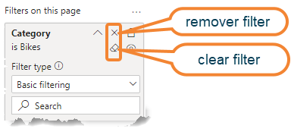
Filter – remove/clear filters
Clear
Click the clear filter icon to the right of the filter
Remove
From page and report level
Click the remove filter icon to the right of the filter
From a visual:
you cannot drag out the field to remove it
Except if the field is not used as data for the visual

Slide 26
Filter - Tips
Avoid complexity
Remind the filters you are using
Make sure the filters are meaningful
Make use of static shapes to comment on your results
See if they are necessary

Slide 27
Slicers
Slicers are kind of filters, but the main difference is that they are always visible allowing direct interaction with the data
We will use the next interaction with slicers
Add, delete, clear, apply, modify
Lay-out updates
Switching to drop-down slicers
Use

Slide 28
Slicers – lay-out updates
Expand the down-facing chevrons.
You will be able to change:
Titles, background, colors, size, selection controls, items, borders, shadow, …

Slide 29
Publishing reports

Slide 30
Publishing reports
Using, adding, and publishing Power BI desktop files in PowerBI.com
Concept of Dashboards, reports, datasets, and workspace
Interacting and working with reports (edit a report, create a report)
Adding, editing/modifying, and deleting tiles from dashboards, modifying dashboards

Slide 31
Publish reports
To publish reports, you have 2 possibilities:
Export directly from Power BI Desktop
First time published in My Workspace
Afterwards, selection of destination workplaces of your account
Import Pbix-files in Power BI services
What happens when you publish a Power BI Desktop file? Following elements are added in the My Workspace section:
The report itself (all the PowerBI Desktop file)
An element added to a new dashboard
The dataset (data behind the report)

Slide 32
PowerBI.com
Power BI dashboards
One-pager telling a story through visualizations containing the highlights of that story. Visuals are pinned from several different reports to this central placeholder
Note a PowerBI Desktop dashboard is one of the pages of your report
Report
Your uploaded pbix-file containing all your pages
Dataset
Underlying data driving your report
Workspace
Places to collaborate with colleagues to create collections of dashboards, reports, datasets and paginated reports

Slide 33
PowerBI.com - workspaces
Workspaces are places to collaborate with colleagues on specific content.
Your turn
Create a new workspace

Slide 34
PowerBI.com - tiles
Tiles are snapshots of your data, pinned to the dashboard.
A tile can be created from a report, a dataset, a dashboard, …
Your turn:
Pin 3 tiles to a new dashboard (name your dashboard test)
Interact with your tiles (resize, move, delete, …)

Slide 35
Interacting with reports
Exercice

Slide 36
bookmarks
concept

Slide 37
Bookmarks
Create report bookmarks
Arranging bookmarks
Bookmarks as a slide show
Assigning bookmarks to buttons (concept)
Bookmark groups/ungroup

Slide 38
Bookmarks
Bookmarks capture the currently configured view of a report page, including filters, slicers and the state of visuals.
Create report bookmarks
In power BI Desktop
In PowerBI.com

Slide 39
Bookmarks
Your turn:
Create 3 different bookmarks
Arrange them
Slide show

Slide 40
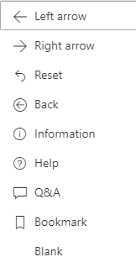
Bookmarks buttons
Concept
You can link shapes/images to bookmarks. It allows you to show the associated bookmark when selecting the object.
This is very useful with buttons. You can create a visual table of content on your report page, or you can provide different views of the same information
How to:
Select your object. In the format shape pane, turn the action slider to on and expand the section. Under type select bookmark and select your bookmark

Slide 41
Bookmarks groups
You can group several bookmarks to create a collection
Note: this can NOT be done with personal bookmarks
Your turn
group
ungroup

Slide 42
Power BI pro

Slide 43
Power BI pro
Sharing dashboards
Apps vs. workspaces (concept)

Slide 44
Power BI pro
Pro (paid) version of PowerBI.com and has greater capacities when it comes to sharing content.
Sharing dashboards
Allows to share your own dashboard with colleagues
Apps vs. workspaces (concept)
My Workspace: not for sharing as you are the only one with access
Other workspaces: used for sharing data between colleagues
App Workspaces platform allowing multiple admins and used for sharing to larger audiences.

Slide 45
Power BI pro
Workspaces
Apps Workspaces
For collaboration
Work area for report authors
Must manage permissions
Viewer could potentially mess up the reports
Allows to bundle reports and dashboards together
View only by default
platform allowing multiple admins and used for sharing to larger audiences.
Used for deployment purposes (I can develop changes and test them before re-publishing the changes to the app)

Slide 46
Data gateways
concept

Slide 47
Data Gateways (concept)
Creates a connection between your data and power BI
Only necessary if data is located on-premises
Allows to refresh data (manually or automatically)
Automatic refresh: on a schedule that you can define
They are 2 kind of gateways
Personal (for yourself only)
Enterprise (designed for multiple users with access control, monitoring and auditing)

Slide 48
Survey
Grab your phone
Scan QR code
Complete the form
Timing: 3 minutes
Notes:
https://forms.office.com/r/nRX5QVE0xa

Slide 49
Q & A time

Slide 50
Appendix
More reading info and useful links

Slide 51
Useful links
Power BI Visuals Reference – SQLBI
Power BI for business users - Power BI | Microsoft Docs

